Slide 1
DSC 530 Final Project

Slide 2
Outline
INTRODUCTION 3
HISTOGRAMS 6
MEAN, MEDIAN, MODE, SPREAD AND TAILS 13
PMF 15
CDF 17
ANALYTICAL DISTRIBUTION 19
SCATTER PLOTS 21
HYPOTHESIS TEST 24
REGRESSION ANALYSIS 26
THANK YOU 28

Slide 3
Introduction

Slide 4
Statistical Question
Do Fire Type Pokémon have higher stats compared to other Pokémon types?

Slide 5
Variables
Total: the attribute total of a particular Pokémon. For example, Bulbasaur, Pokémon # 1, the one that started it all, has a Total of 318. This means Bulbasaur's 45 Health Points (HP), 49 Attack, 49 Defense, 65 Special Attack (Sp. Atk.),65 Special Defense (Sp. Def)., and 45 Speed are all added together to equal their 318 Total or attribute total.
HP (Health Points): how much damage from Attack a Pokémon can take before fainting and becoming unable to battle
Attack: the power of a Pokémon attack
Defense: Reduces attack by this attribute amount.
Speed: Order in which Pokémon will attack
Legendary: One of a kind Pokémon

Slide 6
Histograms

Slide 7
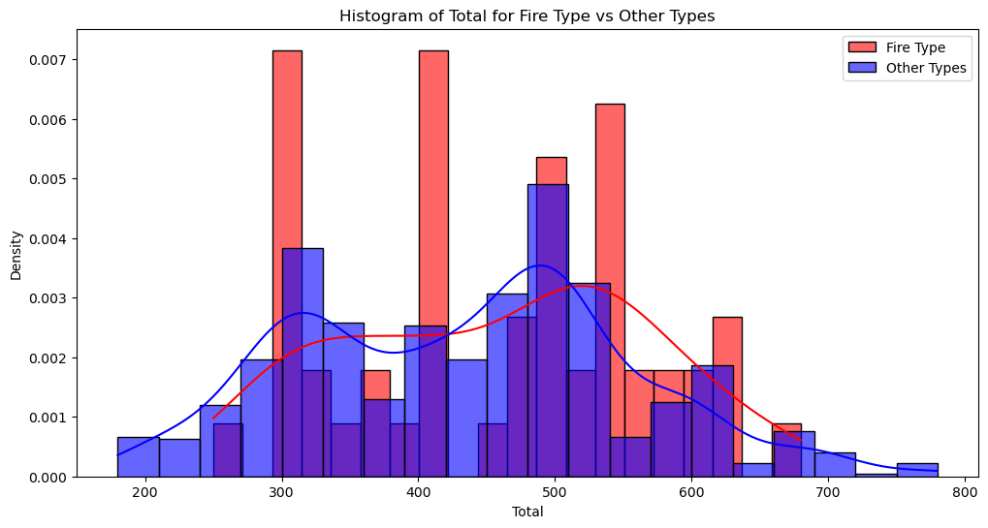

Slide 8
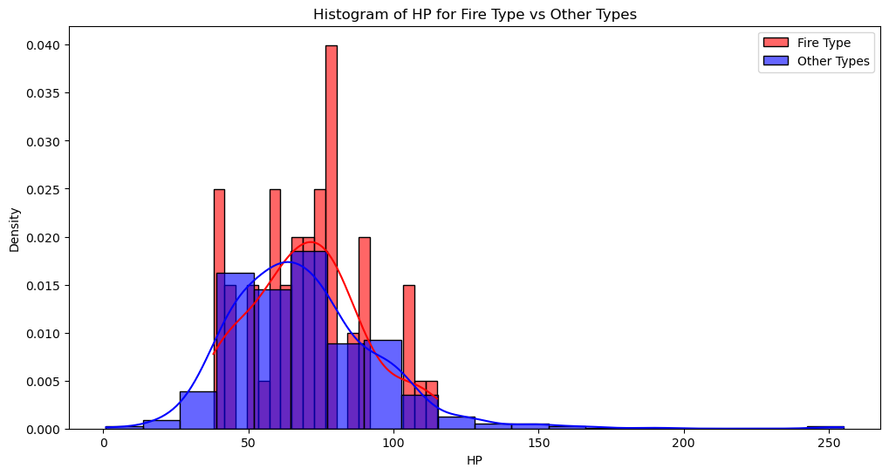

Slide 9
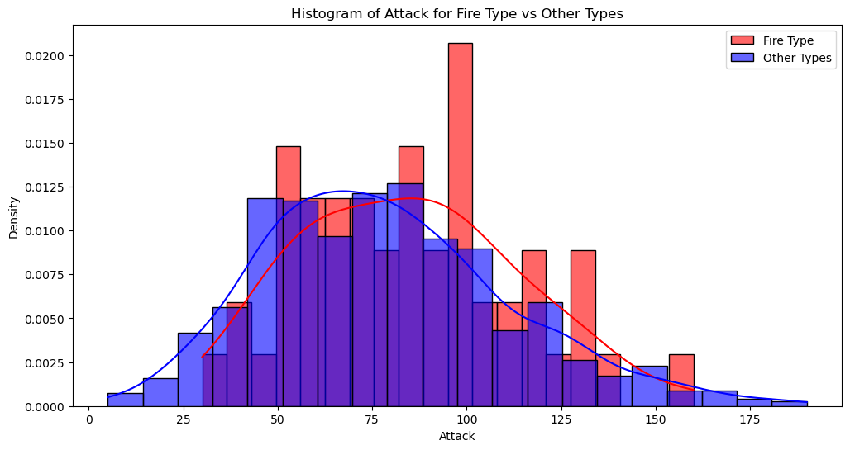

Slide 10
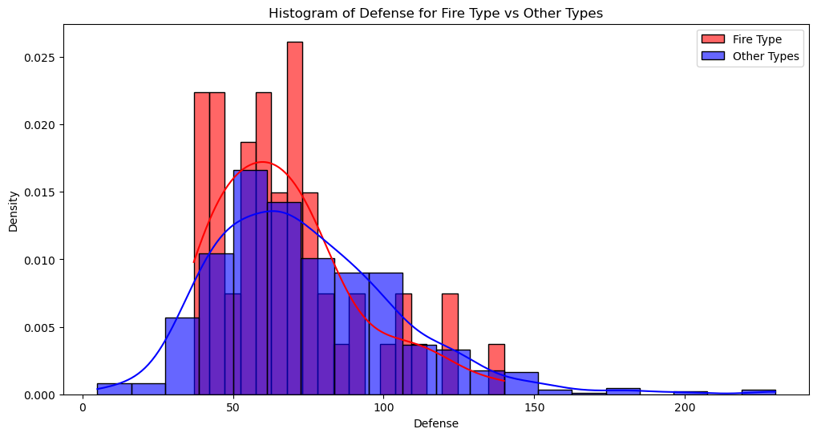

Slide 11
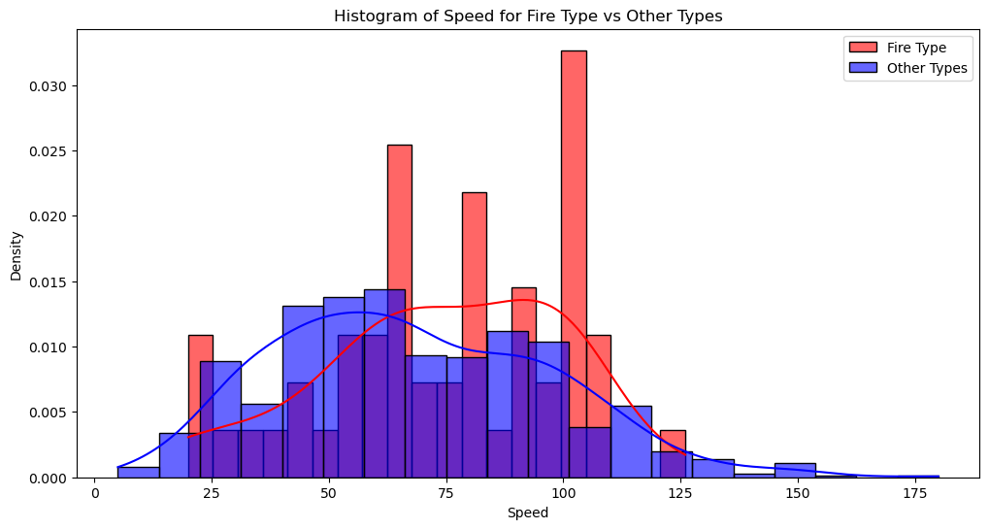

Slide 12
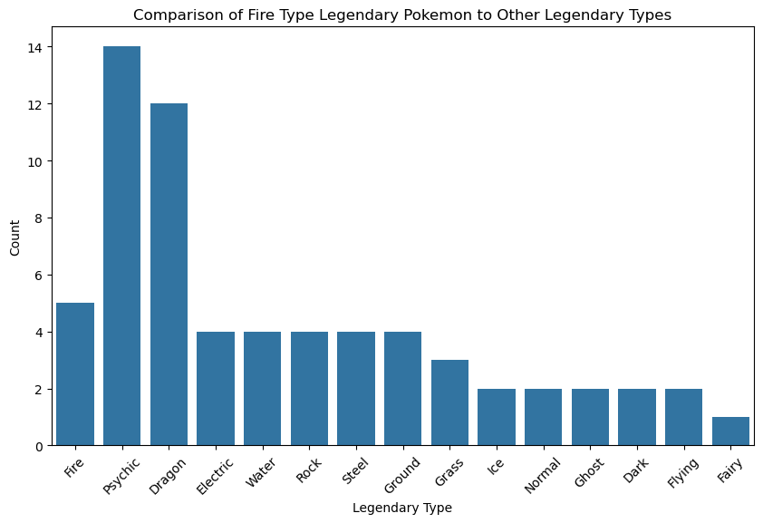

Slide 13
Mean, Median, Mode, Spread and Tails

Slide 14
Histogram of Total for Fire Type vs Other Types:
Descriptive statistics for Total (Fire Type): {'Mean': 458.0769230769231, 'Mode': 405, 'Spread (Std Dev)': 109.76049615338435, 'Tails': {'Skewness': -0.06275679026772849, 'Kurtosis': -1.0239261014213268}} Descriptive statistics for Total (Other Types): {'Mean': 433.5053475935829, 'Mode': 600, 'Spread (Std Dev)': 120.54507496592437, 'Tails': {'Skewness': 0.17086580618913044, 'Kurtosis': -0.4769044392960442}} Histogram of HP for Fire Type vs Other Types: Descriptive statistics for HP (Fire Type): {'Mean': 69.90384615384616, 'Mode': 78, 'Spread (Std Dev)': 19.404122884506883, 'Tails': {'Skewness': 0.3039610282727519, 'Kurtosis': -0.2911384071933947}} Descriptive statistics for HP (Other Types): {'Mean': 69.21390374331551, 'Mode': 60, 'Spread (Std Dev)': 25.9166043698439, 'Tails': {'Skewness': 1.5985398621070595, 'Kurtosis': 7.272507700719929}}
Histogram of Attack for Fire Type vs Other Types: Descriptive statistics for Attack (Fire Type): {'Mean': 84.76923076923077, 'Mode': 85, 'Spread (Std Dev)': 28.769275130832632, 'Tails': {'Skewness': 0.35047789702850574, 'Kurtosis': -0.3116964723469362}} Descriptive statistics for Attack (Other Types): {'Mean': 78.60026737967914, 'Mode': 65, 'Spread (Std Dev)': 32.677677841484005, 'Tails': {'Skewness': 0.5709496878117126, 'Kurtosis': 0.20170275142975402}}
Histogram of Defense for Fire Type vs Other Types: Descriptive statistics for Defense (Fire Type): {'Mean': 67.76923076923077, 'Mode': 40, 'Spread (Std Dev)': 23.658199577309748, 'Tails': {'Skewness': 1.0421343583467988, 'Kurtosis': 0.864818392064095}} Descriptive statistics for Defense (Other Types): {'Mean': 74.26470588235294, 'Mode': 70, 'Spread (Std Dev)': 31.609218408569724, 'Tails': {'Skewness': 1.1409562118900907, 'Kurtosis': 2.6773860877083426}}
Histogram of Speed for Fire Type vs Other Types: Descriptive statistics for Speed (Fire Type): {'Mean': 74.4423076923077, 'Mode': 100, 'Spread (Std Dev)': 25.24578276685657, 'Tails': {'Skewness': -0.4338328655600905, 'Kurtosis': -0.37915722843837685}} Descriptive statistics for Speed (Other Types): {'Mean': 67.84893048128342, 'Mode': 50, 'Spread (Std Dev)': 29.27380618299583, 'Tails': {'Skewness': 0.4041451460666016, 'Kurtosis': -0.19883477831773222}}

Slide 15
PMF

Slide 16
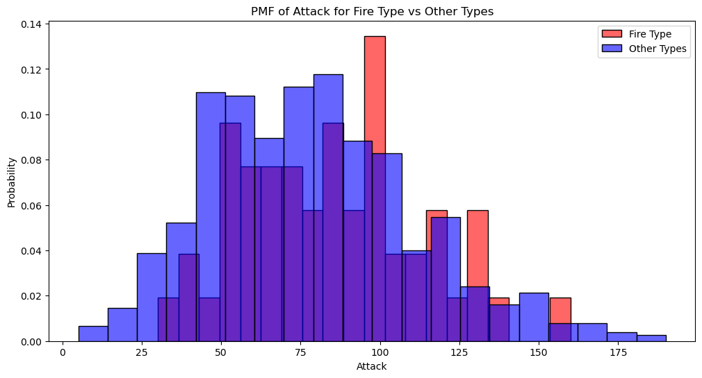

Slide 17
CDF

Slide 18
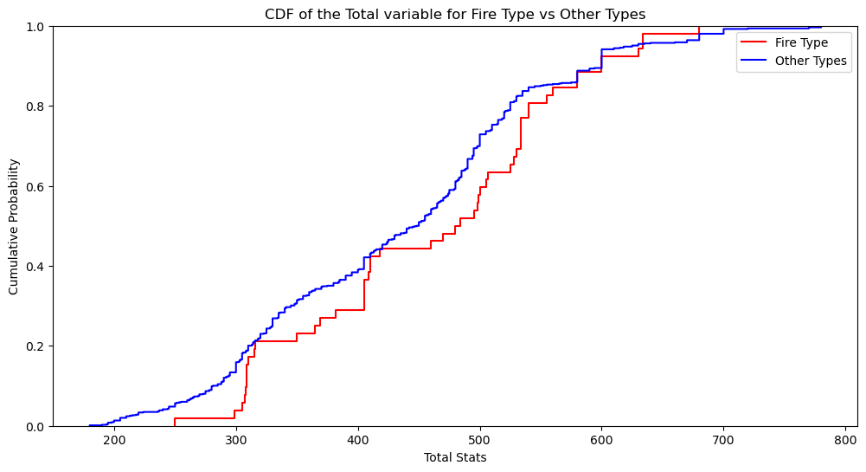

Slide 19
Analytical Distribution

Slide 20
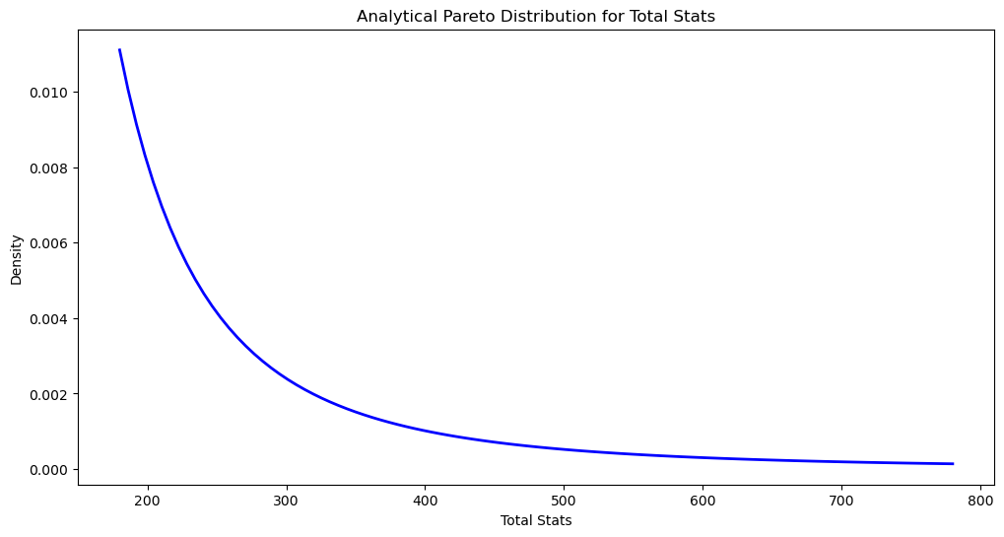

Slide 21
Scatter Plots

Slide 22
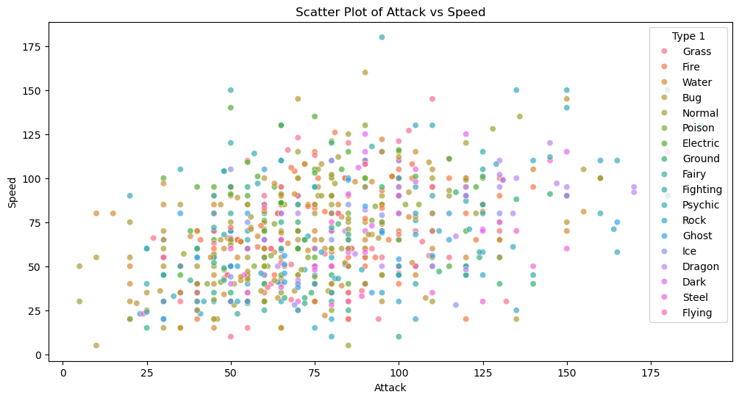

Slide 23
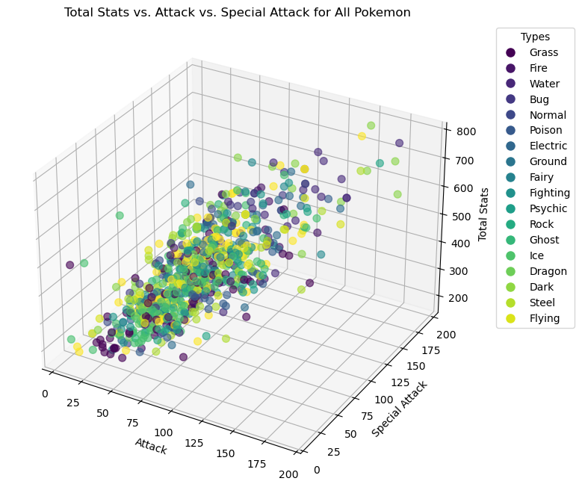

Slide 24
Hypothesis Test

Slide 25
T-statistic: 1.5506143905831495 P-value: 0.12626350091288374

Slide 26
Regression Analysis

Slide 27
OLS Regression Results
==============================================================================
Dep. Variable: Total
Model: OLS
Method: Least Squares
Date: Sat, 01 Mar 2025
Time: 20:54:52
No. Observations: 800
Df Residuals: 798
Df Model: 1
Covariance Type: nonrobust
R-squared: 0.003
Adj. R-squared: 0.001
F-statistic: 2.042
Prob (F-statistic): 0.153
Log-Likelihood: -4963.4
AIC: 9931
BIC: 9940
==============================================================================
coef std err t P>|t| [0.025 0.975]
------------------------------------------------------------------------------
const 433.5053 4.383 98.897 0.000 424.901 442.110
Fire_Type 24.5716 17.193 1.429 0.153 -9.178 58.321
==============================================================================
Omnibus: 17.895
Prob(Omnibus): 0.000
Skew: 0.159
Kurtosis: 2.499
Durbin-Watson: 1.574
Jarque-Bera (JB): 11.726
Prob(JB): 0.00280
Cond. No. 4.07
==============================================================================

Slide 28
Thank you
Nicholas Rodriguez
DSC 530 T301

